Slide 1
Chapter 7 Conversion Functions
Oracle 12c Database

Slide 2
Chapter 7 Functions
Conversion Functions and Conditional Expressions

Slide 3
Conversion Functions
Data type
conversion
Implicit data type
conversion
Explicit data type
conversion

Slide 4
Conversion Functions
However, the Oracle server internally converts such data types to Oracle data types.
In some cases, the Oracle server receives data of one data type where it expects data of a different data type. When this happens, the Oracle server can automatically convert the data to the expected data type. This data type conversion can be done implicitly by the Oracle server or explicitly by the user.
Implicit data type conversions work according to the rules explained in the next two slides.
Explicit data type conversions are done by using the conversion functions. Conversion functions convert a value from one data type to another.
Generally, the form of the function names follows the convention data type TO data type.
The first data type is the input data type and the second data type is the output.

Slide 5
Conversion Functions
Implicit data type conversions work according to the rules explained in the next two slides.
Explicit data type conversions are done by using the conversion functions. Conversion functions convert a value from one data type to another.
Generally, the form of the function names follows the convention data type TO data type.
The first data type is the input data type and the second data type is the output

Slide 6
Implicit Datatype Conversion
In expressions, the Oracle server can automatically convert the following:
For expression evaluation, Oracle server can automatically convert the following:
From
To
VARCHAR2 or CHAR
NUMBER
VARCHAR2 or CHAR
DATE
From
To
NUMBER
VARCHAR2 or CHAR
DATE
VARCHAR2 or CHAR

Slide 7
Explicit Data Type Conversion
SQL provides three functions to convert a value from one data type to another:
TO_NUMBER
TO_DATE
NUMBER
CHARACTER
DATE
TO_CHAR
TO_CHAR

Slide 8
Format Model
A format model is a character literal that describes the format of datetime stored in a character string. For example, the datetime format model for the string '11-Nov-1999' is 'DD-Mon-YYYY’.
TO_CHAR converts a datetime data type to a value of VARCHAR2 data type in the format specified by the format_model.
Syntax :
The format model:
Must be enclosed with single quotation marks
Is case-sensitive
Can include any valid date format element
Has an fm element to remove padded blanks or suppress leading zeros
Is separated from the date value by a comma.
TO_CHAR(date, 'format_model')

Slide 9
Elements of the Date Format Model
Element
Result
YYYY
Full year in numbers
YEAR
Year spelled out (in English)
MM
Two-digit value for the month
MONTH
Full name of the month
MON
Three-letter abbreviation of the month
DY
Three-letter abbreviation of the day of the week
DAY
Full name of the day of the week
DD
Numeric day of the month

Slide 10
Elements of the Time Format Model
Time elements format the time portion of the date:
Add character strings by enclosing them with double quotation marks:
Number suffixes spell out numbers:
HH24:MI:SS AM
15:45:32 PM
DD "of" MONTH
12 of OCTOBER
ddspth
fourteenth

Slide 11
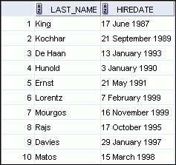

Using the TO_CHAR Function with Dates
SELECT last_name,
TO_CHAR(hire_date, 'fmDD Month YYYY')
AS HIREDATE
FROM employees;

Slide 12
Using the TO_CHAR Function with Numbers
These are some of the format elements that you can use with the TO_CHAR function to display a number value as a character:
TO_CHAR(number, 'format_model')
Element
Result
9
Represents a number
0
Forces a zero to be displayed
$
Places a floating dollar sign
L
Uses the floating local currency symbol
.
Prints a decimal point
,
Prints a comma as a thousands indicator

Slide 13

Using the TO_CHAR Function with Numbers
The Oracle server displays a string of number signs (#) in place of a whole number whose digits exceed the number of digits provided in the format model.
The Oracle server rounds the stored decimal value to the number of decimal places provided in the format model.
SELECT TO_CHAR(salary, '$99,999.00') SALARY
FROM employees
WHERE last_name = 'Ernst';

Slide 14
Using the TO_NUMBER and TO_DATE Functions
Convert a character string to a number format using the TO_NUMBER function:
Convert a character string to a date format using the TO_DATE function:
These functions have an fx modifier. This modifier specifies the exact match for the character argument and date format model of a TO_DATE function.
TO_NUMBER(char[, 'format_model'])
TO_DATE(char[, 'format_model'])

Slide 15

Nesting Functions
Single-row functions can be nested to any level.
Nested functions are evaluated from the deepest level to the least deep level.
F3(F2(F1(col,arg1),arg2),arg3)
Step 1 = Result 1
Step 2 = Result 2
Step 3 = Result 3
SELECT last_name,
UPPER(CONCAT(SUBSTR (LAST_NAME, 1, 8), '_US'))
FROM employees
WHERE department_id = 60;

Slide 16
General Functions
The following functions work with any data type and pertain to using nulls:
1. NVL (expr1, expr2) 2. NVL2 (expr1, expr2, expr3) 3. NULLIF (expr1, expr2)
4. COALESCE (expr1, expr2, ..., exprn)
NVL function Converts a null value to an actual value:
Data types that can be used are date, character, and number. Data types must match:
1. NVL(commission_pct,0) 2. NVL(hire_date,'01-JAN-97’)
3. NVL(job_id,'No Job Yet')

Slide 17
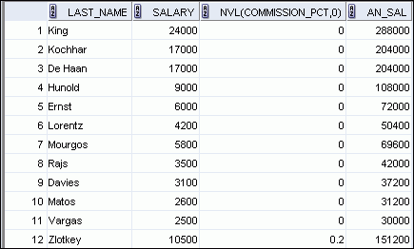
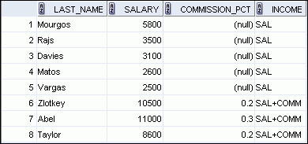
Using the NVL and NVL2 Function
1
SELECT last_name, salary, NVL(commission_pct, 0),
(salary*12) + (salary*12*NVL(commission_pct, 0)) AN_SAL
FROM employees;
2
1
SELECT last_name, salary, commission_pct,
NVL2(commission_pct,
'SAL+COMM', 'SAL') income
FROM employees WHERE department_id IN (50, 80);
2
…
1
2
1
2
Notes:
The NVL2 function examines the first expression. If the first expression is not null, then the NVL2 function returns the second expression. If the first expression is null, then the third expression is returned

Slide 18
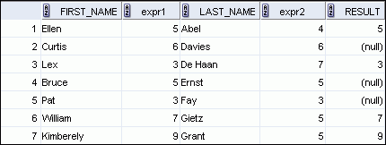
Using the NULLIF Function
1
The NULLIF function compares two expressions. If they are equal, the function returns a null. If they are not equal, the function returns the first expression. However, you cannot specify the literal NULL for the first expression
SELECT first_name, LENGTH(first_name) "expr1",
last_name, LENGTH(last_name) "expr2",
NULLIF(LENGTH(first_name), LENGTH(last_name)) result
FROM employees;
2
…
1
2
3

Slide 19
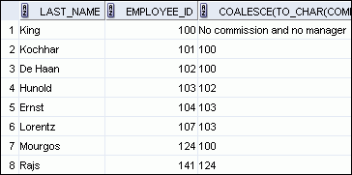
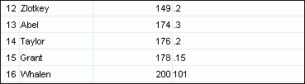
Using the COALESCE Function
The advantage of the COALESCE function over the NVL function is that the COALESCE function can take multiple alternate values.
If the first expression is not null, the COALESCE function returns that expression; otherwise, it does a COALESCE of the remaining expressions.
SELECT last_name, employee_id,
COALESCE(TO_CHAR(commission_pct),TO_CHAR(manager_id),
'No commission and no manager')
FROM employees;

Slide 20
Conditional Expressions
Provide the use of the IF-THEN-ELSE logic within a SQL statement
Use two methods:
CASE expression
DECODE function
Facilitates conditional inquiries by doing the work of an IF-THEN-ELSE statement:
CASE expr WHEN comparison_expr1 THEN return_expr1
[WHEN comparison_expr2 THEN return_expr2
WHEN comparison_exprn THEN return_exprn
ELSE else_expr]
END

Slide 21
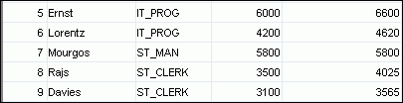
CASE Expression
Facilitates conditional inquiries by doing the work of an IF-THEN-ELSE statement:
SELECT last_name, job_id, salary,
CASE job_id WHEN 'IT_PROG' THEN 1.10*salary
WHEN 'ST_CLERK' THEN 1.15*salary
WHEN 'SA_REP' THEN 1.20*salary
ELSE salary END "REVISED_SALARY"
FROM employees;
…
…
Notes:
Using the CASE Expression
In the SQL statement in the slide, the value of JOB_ID is decoded. If JOB_ID is IT_PROG, the salary increase is 10%; if JOB_ID is ST_CLERK, the salary increase is 15%; if JOB_ID is SA_REP, the salary increase is 20%. For all other job roles, there is no increase in salary.
The same statement can be written with the DECODE function.
This is an example of a searched CASE expression. In a searched CASE expression, the search occurs from left to right until an occurrence of the listed condition is found, and then it returns the return expression. If no condition is found to be true, and if an ELSE clause exists, the return expression in the ELSE clause is returned; otherwise, a NULL is returned.
SELECT last_name,salary,
(CASE WHEN salary<5000 THEN 'Low'
WHEN salary<10000 THEN 'Medium'
WHEN salary<20000 THEN 'Good'
ELSE 'Excellent'
END) qualified_salary
FROM employees;

Slide 22


Using the DECODE Function
Facilitates conditional inquiries by doing the work of a CASE expression or an IF-THEN-ELSE statement:
DECODE function compares expression against each search value in order. If equality exists between expression and search argument, then it returns the corresponding result. In case of no match, default value is returned, if defined, else NULL. In case of any type compatibility mismatch, oracle internally does possible implicit conversion to return the results
SELECT last_name, job_id, salary,
DECODE(job_id, 'IT_PROG', 1.10*salary,
'ST_CLERK', 1.15*salary,
'SA_REP', 1.20*salary,
salary)
REVISED_SALARY
FROM employees;
…
…

Slide 23
Using the DECODE Function
Display the applicable tax rate for each employee in department 80:
SELECT last_name, salary,
DECODE (TRUNC(salary/2000, 0),
0, 0.00,
1, 0.09,
2, 0.20,
3, 0.30,
4, 0.40,
5, 0.42,
6, 0.44,
0.45) TAX_RATE
FROM employees
WHERE department_id = 80;

Slide 24
THANK YOU

